Slide 1
Commercial Sales Data Analytics Report
A Data-Driven Insight into Sales and Trends
By: Hetvi Parekh
24 -Jun - 2025

Slide 2
Overview
This Project analyzes commercial sales data to identify high- performing product categories, peak sales periods and customer behavior. It uses Excel for data processing and Tableau for visualization. The insights aim to help in strategic planning and improving revenue.

Slide 3
Key Objectives and Technology
Goal
Analyze overall and category wise sales performance.
Identify top-selling products.
Determine sales trends across months / regions.
Highlight low-performing area for improvement.
Technology
Ms Excel (Data Processing)
Tableau (Visualization)

Slide 4
All about Dataset.
Source
Kaggle.com
Size
1000 x 8
Fields
OrderId, Date, CustomerId, Category, Total Price, Payment Method, Branch, Revenue
Time Period
Jan 2024 – Dec 2024

Slide 5
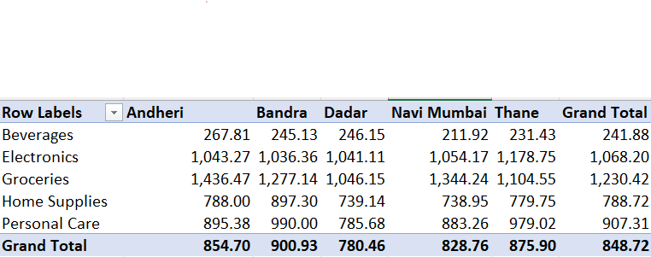
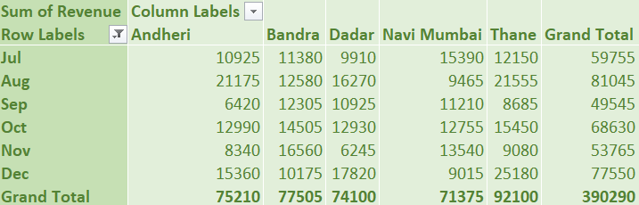
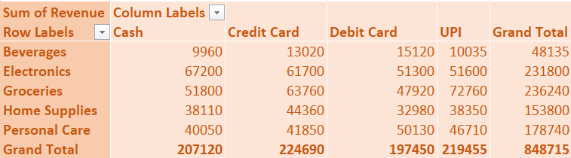
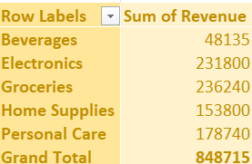
Pivot Table

Slide 6
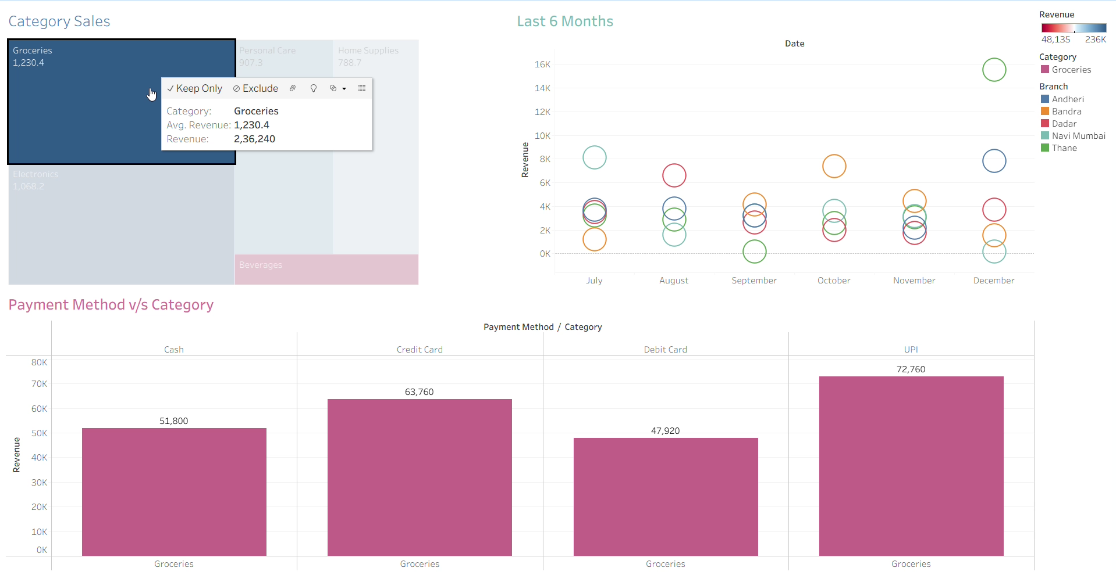
Data Visualization

Slide 7
Key Insights and Findings.
Groceries dominate total revenue, followed by Electronics. Beverages contribute least to sales – this might need a push or promotional strategies.
No major seasonal spike is visible, but November shows potential. Targeting for campaigns may yield higher returns.
UPI and Credit card are the preferred modes for Groceries.
Cash is still widely used for Electronics.
Across all modes, Beverages have low engagement, possibly due to pricing, availability or consumer preferences.
Sales are steady but could be boosted during lower-performing months.

Slide 8
Recommendations
Launch branch-specific offers for underperforming categories.
Encourage UPI adoption via cashback or digital discounts.
Plan for monthly goals using insights from past performance.

Slide 9
THANK YOU FOR ATTENTION
Gmail: hetviparekh245@gmail.com
LinkedIn: Hetvi Parekh

